Slide 1
Facility Planning Committee
April 26, 2023
Blue Valley Schools | Facility Planning Committee

Slide 2
Committee Purpose:
The Facility Planning Committee examines and evaluates boundary alternatives and recommends options for a comprehensive boundary master plan to the Board of Education.
Blue Valley Schools | Facility Planning Committee

Slide 3
Board of Education Goal for 2022-23
“Blue Valley Schools will evaluate school boundaries and develop a plan to address elementary school enrollment and building capacity issues.”
Blue Valley Schools | Facility Planning Committee

Slide 4
School Discussions
TOOLS FOR ENROLLMENT ADJUSTMENTS
Closure to incoming transfers
Reclaim program space
Building additions or modifications
New school construction
Adjust attendance boundaries
Blue Valley Schools | Facility Planning Committee

Slide 5
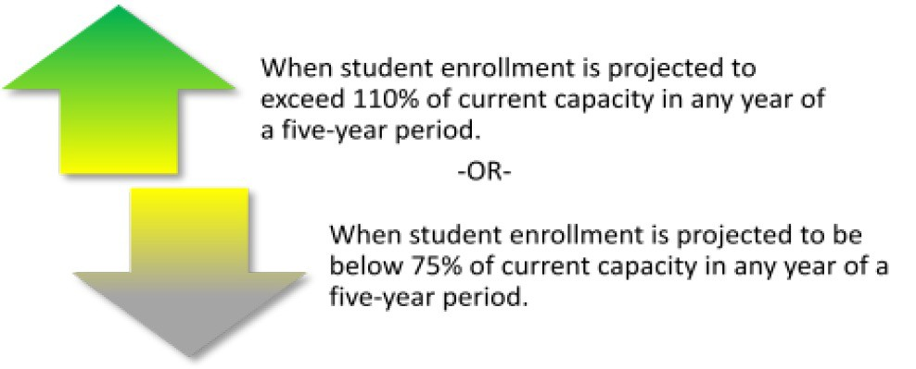
Understanding the Colors
Projection table key:
Green cells: Exceeds 110% capacity
Yellow cells: Between 75% and 110% capacacity Gray cells: Below 75% capacity
Also: Elementary projections in highlight schools where a projection
blue text
exceeds 600 students. This will not always exceed 110% capacity for available classrooms but represents a number that creates challenges for shared spaces and resources.
Blue Valley Schools | Finance & Operations

Slide 6
Boundary Criteria for Existing Schools
Projected Enrollment and Building Utilization: Building utilization, student enrollment, staffing needs and educational programs. Where possible, attendance boundaries should be created to anticipate the projected enrollment and the program/current capacity of the building. Efficient building utilization should attempt to maximize student population without exceeding capacity long-term.
Duration of Boundaries: The ability of an attendance area to accommodate the anticipated enrollments for a projected period. Where possible, attendance areas should be stabilized to limit the number of boundary changes experienced by students.
Fiscal Considerations – Operational: Where possible, boundaries should be planned to maximize district resources in a fiscally responsible manner and take advantage of economies of scale. This factor should consider staffing requirements, educational program needs, and other operational costs.
Feeder System Considerations: Where possible, create boundaries between elementary, middle, and high schools to have as many schools as possible at each educational level advance students as one group to the next higher educational level.
Neighborhoods Intact Within Attendance Areas: Where possible, boundaries should be structured to maintain a neighborhood within one school's attendance area. Neighborhoods should not be split between two schools. A neighborhood is defined as the smallest division of a subdivision and/or an area that can be subdivided by a natural line of demarcation, such as a stream or major traffic way.
Contiguous Attendance Areas: Where possible, contiguous attendance areas should be maintained.
Students Impacted by a Boundary Change: Where possible, minimize the number of existing students impacted by a boundary change. Consideration should be given that not only can too many students be affected by a potential boundary change, but also that moving a small number of students from one particular school could have a negative impact as well.
Transportation Considerations: While students may not necessarily attend the closest school; distance, transportation time, and routing should be considered, and minimized where possible, in formulating attendance boundaries.
Fiscal Considerations – Capital: The impact on capital costs should be considered. This factor should consider new facility construction, building additions and/or remodeling, mobile classrooms, demountable wall relocations, and other capital costs.
Blue Valley Schools | Facility Planning Committee

Slide 7
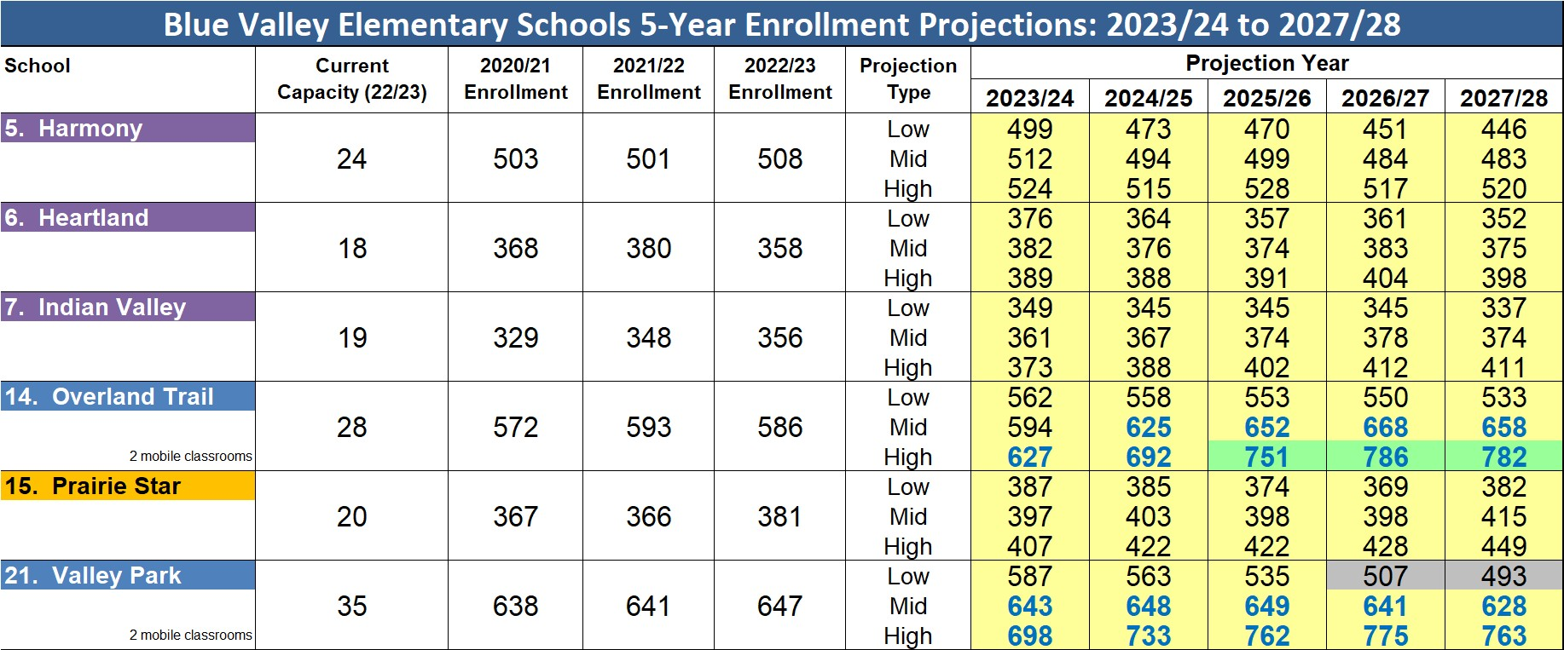
Pre-Adjustment Projections
Blue Valley Schools | Facility Planning Committee

Slide 8
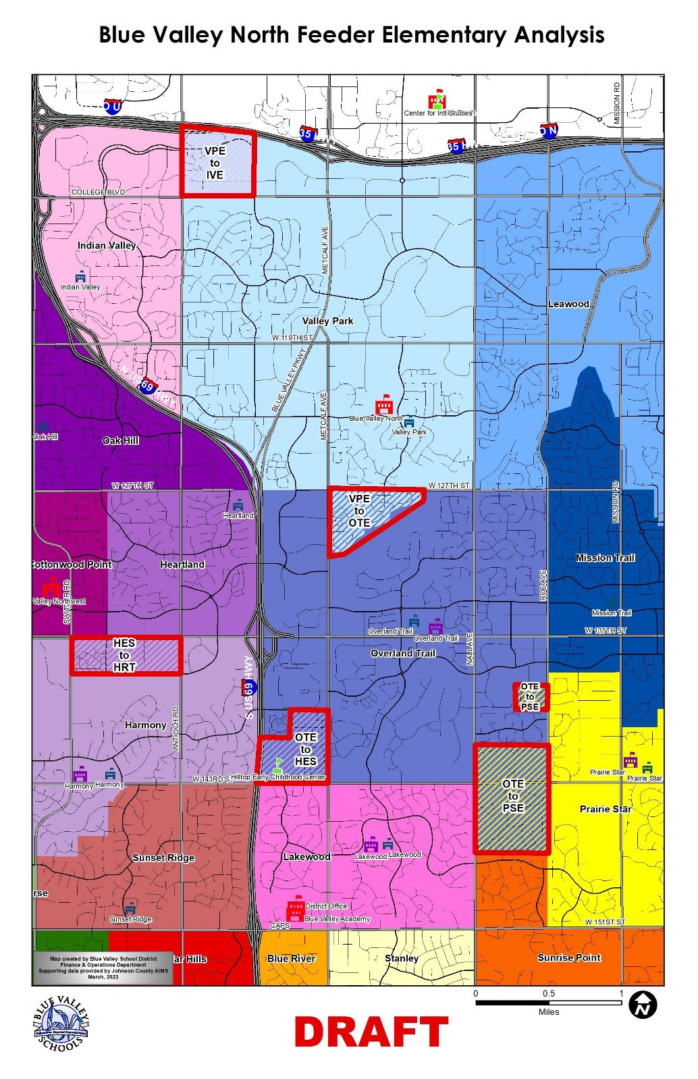
Previous Recommendation
(April 5th)

Slide 9
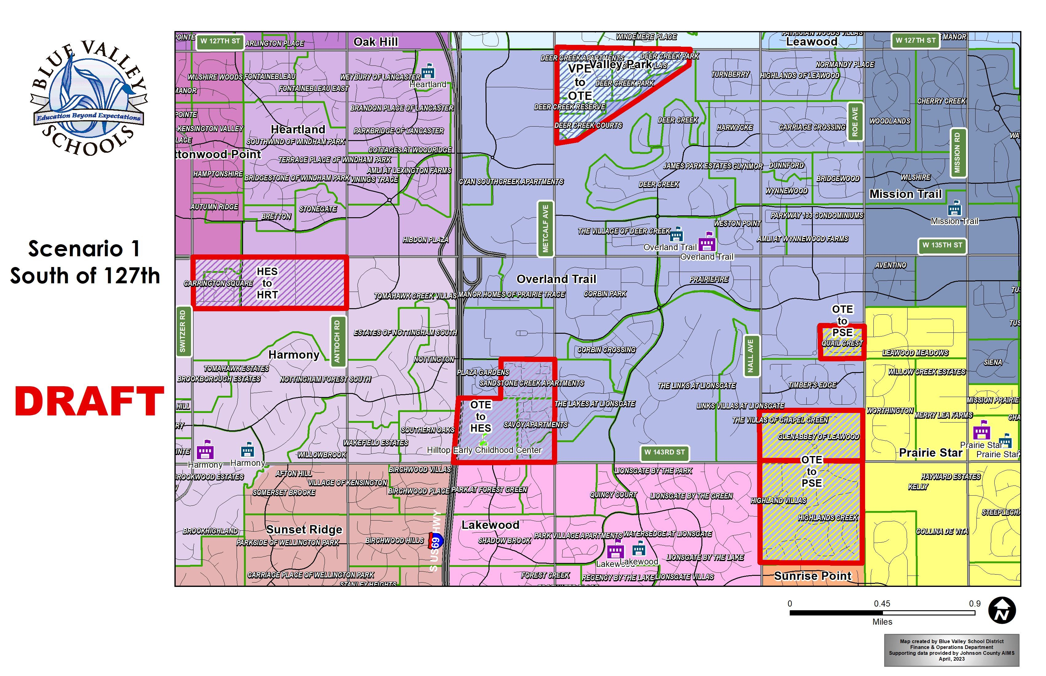

Slide 10
Scenario 1
Neighborhood Planning Area | Proposed Change | 2024/25 Projected Elementary Students
Autumn Park (Arcadia) | Valley Park to Indian Valley | 28
Villages of Overland View
Executive Hills
Deer Creek (S. of 127th St) | Valley Park to Overland Trail | 23
Sandstone Creek | Overland Trail to Harmony | 53
Savoy
Villas of Carrington Square Area | Harmony to Heartland | 48
Quail Crest | Overland Trail to Prairie Star | 39
Glen Abbey & Villas of Chapel Green
Highland Villas & Highlands Creek

Slide 11
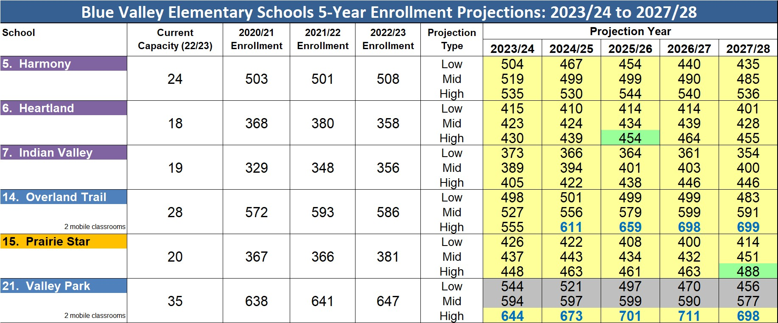
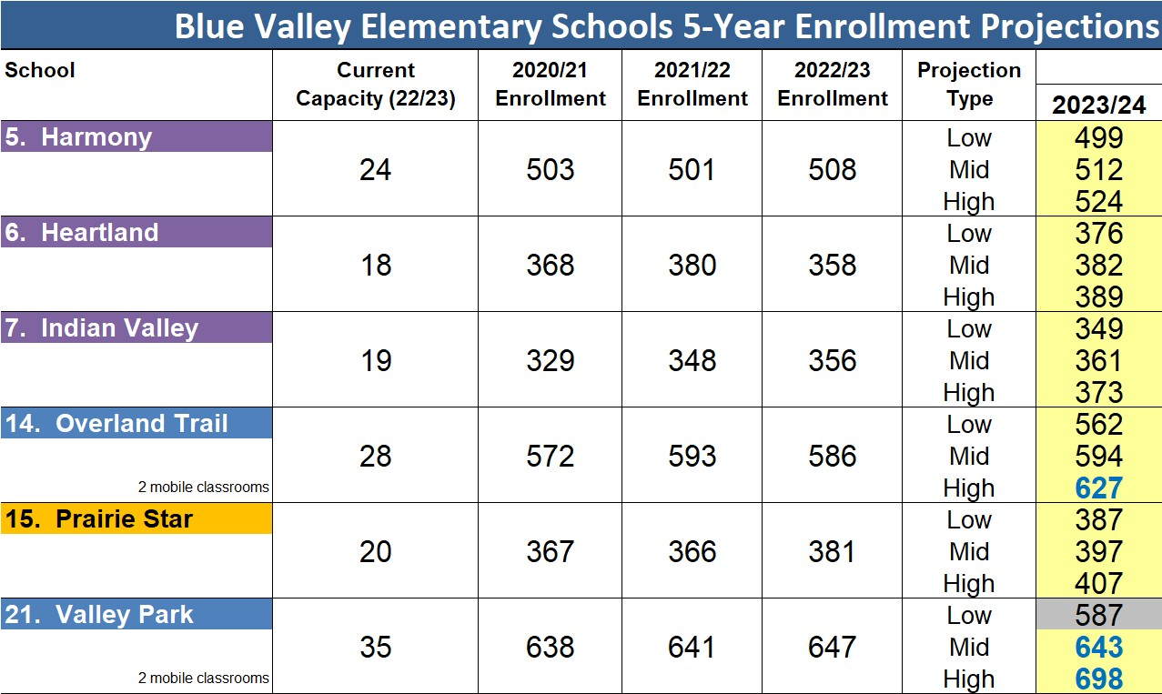
Draft Adjustments
Post-Adjustment Projections: Scenario 1
Blue Valley Schools | Facility Planning Committee

Slide 12
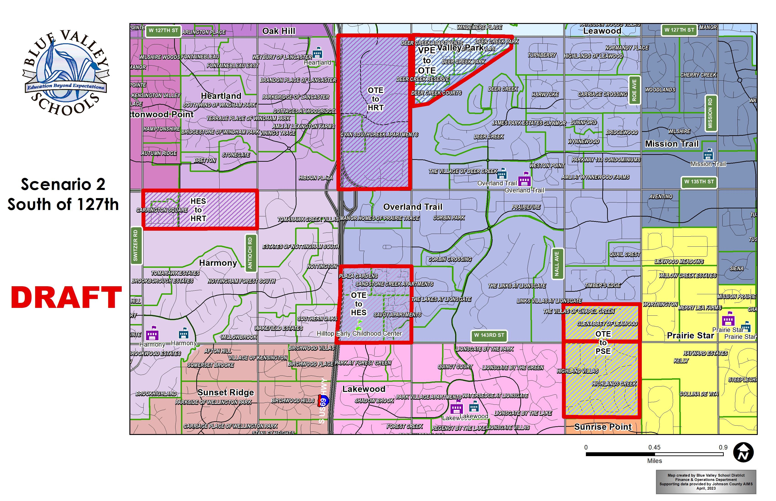

Slide 13
Scenario 2
Neighborhood Planning Area | Proposed Change | 2024/25 Projected Elementary Students
Autumn Park (Arcadia) | Valley Park to Indian Valley | 28
Villages of Overland View
Executive Hills
Deer Creek (S. of 127th St) | Valley Park to Overland Trail | 23
Sandstone Creek | Overland Trail to Harmony | 100
Savoy
Plaza Gardens
Villas of Carrington Square Area | Harmony to Heartland | 48
Cyan Southcreek | Overland Trail to Heartland | 11
Glen Abbey & Villas of Chapel Green | Overland Trail to Prairie Star | 21
Highland Villas & Highlands Creek

Slide 14
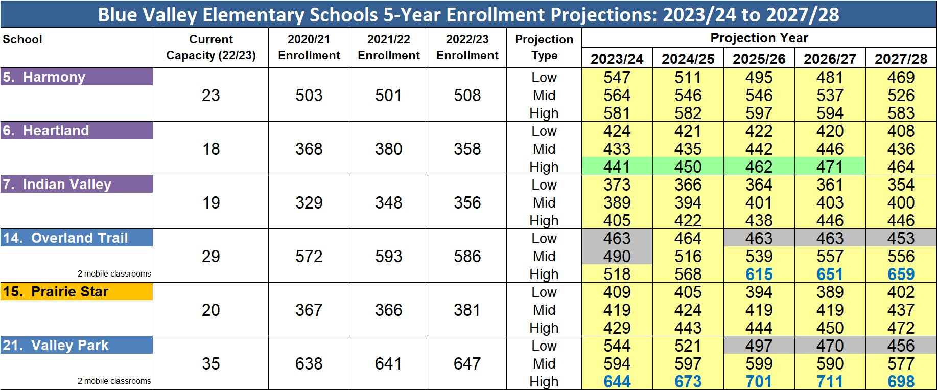
Draft Adjustments
Post-Adjustment Projections: Scenario 2
Blue Valley Schools | Facility Planning Committee

Slide 15
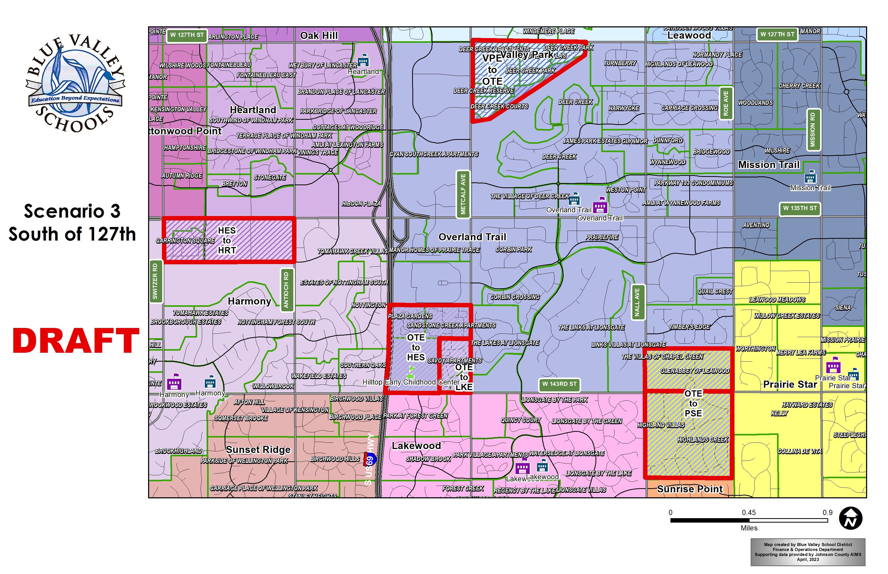

Slide 16
Scenario 3
Neighborhood Planning Area | Proposed Change | 2024/25 Projected Elementary Students
Autumn Park (Arcadia) | Valley Park to Indian Valley | 28
Villages of Overland View
Executive Hills
Deer Creek (S. of 127th St) | Valley Park to Overland Trail | 23
Sandstone Creek | Overland Trail to Harmony | 80
Plaza Gardens
Villas of Carrington Square Area | Harmony to Heartland | 48
Savoy | Overland Trail to Lakewood | 20
Glen Abbey & Villas of Chapel Green | Overland Trail to Prairie Star | 21
Highland Villas & Highlands Creek

Slide 17
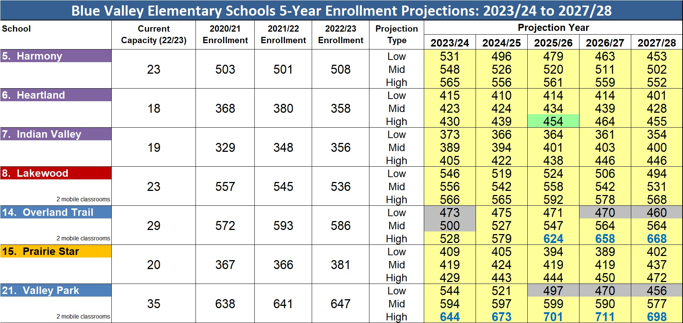
Draft Adjustments
Post-Adjustment Projections: Scenario 3
Blue Valley Elementary Schools 5-Year Enrollment Projections
School | Current Capacity (22/23) | 2020/21 Enrollment | 2021/22 Enrollment | 2022/23 Enrollment | Projection Type
 |  |  |  |  |  | 2023/24
5. Harmony | 24 | 503 | 501 | 508 | Low | 499
 |  |  |  |  | Mid | 512
 |  |  |  |  | High | 524
6. Heartland | 18 | 368 | 380 | 358 | Low | 376
 |  |  |  |  | Mid | 382
 |  |  |  |  | High | 389
7. Indian Valley | 19 | 329 | 348 | 356 | Low | 349
 |  |  |  |  | Mid | 361
 |  |  |  |  | High | 373
8. Lakewood | 24 | 557 | 545 | 536 | Low | 530
 |  |  |  |  | Mid | 540
2 mobile classrooms |  |  |  |  | High | 550
14. Overland Trail | 28 | 572 | 593 | 586 | Low | 562
 |  |  |  |  | Mid | 594
2 mobile classrooms |  |  |  |  | High | 627
15. Prairie Star | 20 | 367 | 366 | 381 | Low | 387
 |  |  |  |  | Mid | 397
 |  |  |  |  | High | 407
21. Valley Park | 35 | 638 | 641 | 647 | Low | 587
 |  |  |  |  | Mid | 643
2 mobile classrooms |  |  |  |  | High | 698
Blue Valley Schools | Facility Planning Committee

Slide 19
Scenario 4
Neighborhood Planning Area | Proposed Change | 2024/25 Projected Elementary Students
Autumn Park (Arcadia) | Valley Park to Indian Valley | 28
Villages of Overland View
Executive Hills
Deer Creek (S. of 127th St) | Valley Park to Overland Trail | 23
Sandstone Creek | Overland Trail to Harmony | 100
Savoy
Plaza Gardens
Villas of Carrington Square Area | Harmony to Heartland | 48
Glen Abbey & Villas of Chapel Green | Overland Trail to Prairie Star | 21
Highland Villas & Highlands Creek

Slide 20
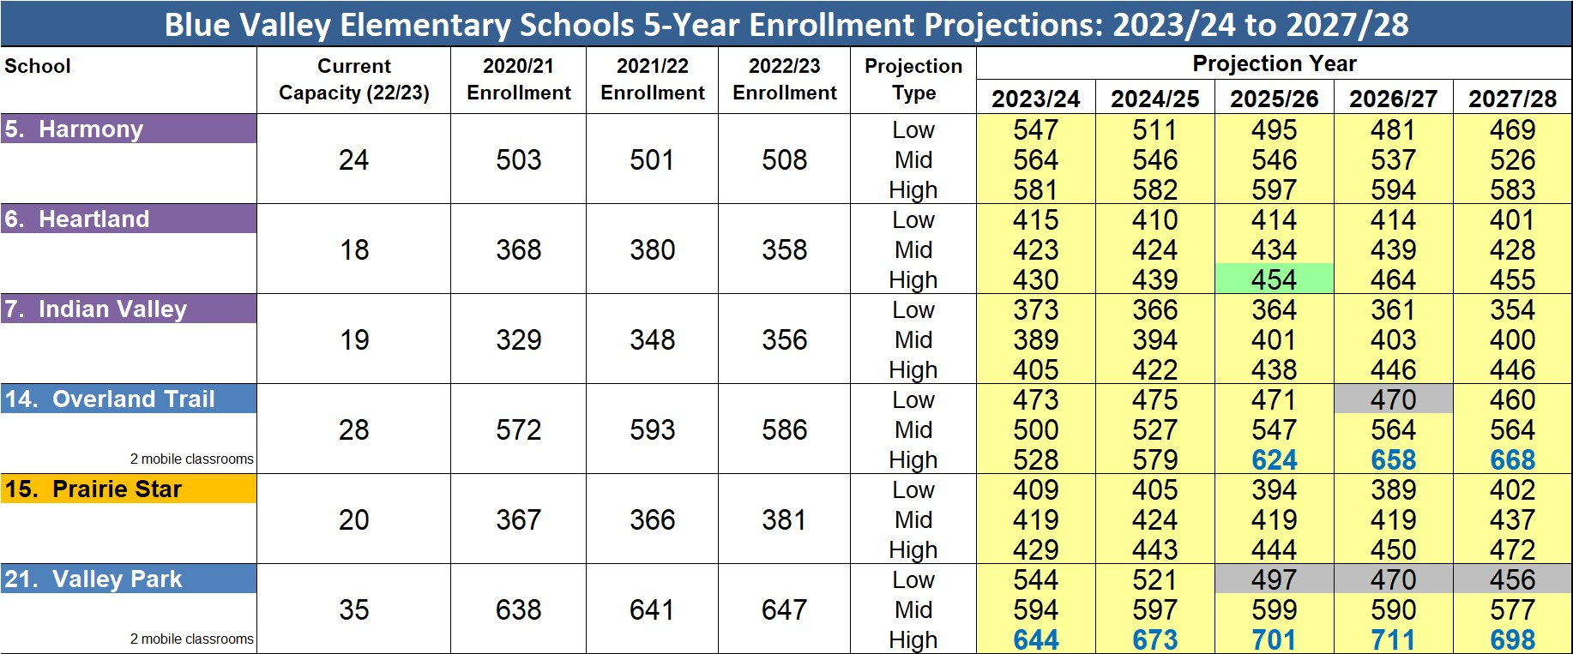
Draft Adjustments
Post-Adjustment Projections: Scenario 4
Blue Valley Schools | Facility Planning Committee

Slide 21
Pre-Adjustment Projections
Blue Valley Elementary Schools 5-Year Enrollment Projections: 2023/24 to 2027/28
School | Current Capacity (22/23) | 2020/21 Enrollment | 2021/22 Enrollment | 2022/23 Enrollment | Projection Type | Projection Year
 |  |  |  |  |  | 2023/24 | 2024/25 | 2025/26 | 2026/27 | 2027/28
5. Harmony | 24 | 503 | 501 | 508 | Low Mid High | 499 512 524 | 473 494 515 | 470 499 528 | 451 484 517 | 446 483 520
6. Heartland | 18 | 368 | 380 | 358 | Low Mid High | 376 382 389 | 364 376 388 | 357 374 391 | 361 383 404 | 352 375 398
7. Indian Valley | 19 | 329 | 348 | 356 | Low Mid High | 349 361 373 | 345 367 388 | 345 374 402 | 345 378 412 | 337 374 411
8. Lakewood | 24 | 557 | 545 | 536 | Low Mid High | 530 540 550 | 504 521 539 | 508 532 556 | 488 516 543 | 477 507 537
2 mobile classrooms
14. Overland Trail | 28 | 572 | 593 | 586 | Low Mid High | 562 594 627 | 558 625 692 | 553 652 | 550 668 | 533 658
2 mobile classrooms
 |  |  |  |  |  |  |  | 751 | 786 | 782
15. Prairie Star | 20 | 367 | 366 | 381 | Low Mid High | 387 397 407 | 385 403 422 | 374 398 422 | 369 398 428 | 382 415 449
21. Valley Park | 35 | 638 | 641 | 647 | Low Mid High | 587 643 698 | 563 648 733 | 535 649 762 | 507 | 493
2 mobile classrooms |  |  |  |  |  |  |  |  | 641 775 | 628 763
Blue Valley Schools | Facility Planning Committee

Slide 22
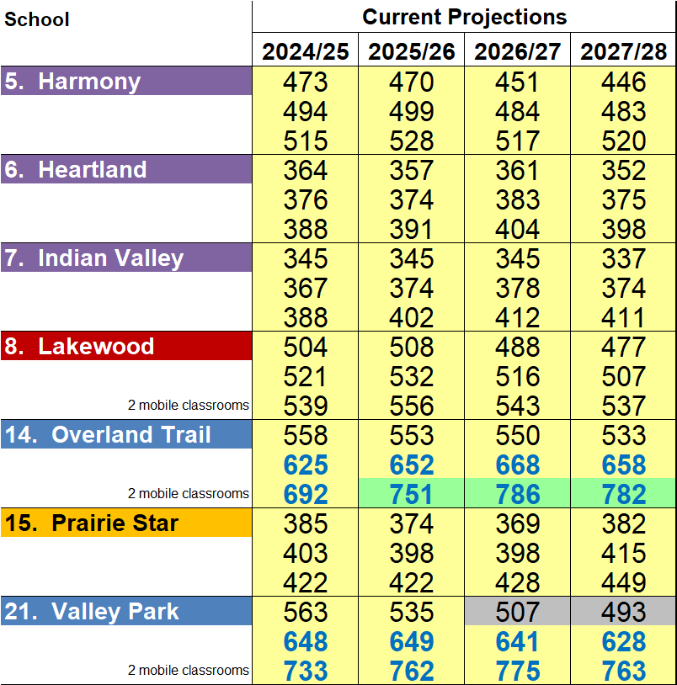
Scenario Comparisons
 | Scenario 1 |  |  |  | Scenario 2 |  |  |  | Scenario 3 |  |  |  | Scenario 4
 | 2024/25 | 2025/26 | 2026/27 | 2027/28 | 2024/25 | 2025/26 | 2026/27 | 2027/28 | 2024/25 | 2025/26 | 2026/27 | 2027/28 | 2024/25 | 2025/26 | 2026/27 | 2027/28
 | 467 499 530 | 454 499 544 | 440 490 540 | 435 485 536 | 511 546 582 | 495 546 597 | 481 537 594 | 469 526 583 | 496 526 556 | 479 520 561 | 463 511 559 | 453 502 552 | 511 546 582 | 495 546 597 | 481 537 594 | 469 526 583
 | 410 424 439 | 414 434 | 414 439 464 | 401 428 455 | 421 435 | 422 442 | 420 446 | 408 436 464 | 410 424 439 | 414 434 | 414 439 464 | 401 428 455 | 410 424 439 | 414 434 | 414 439 464 | 401 428 455
 |  | 454 |  |  | 450 | 462 | 471 |  |  | 454 |  |  |  | 454
 | 366 394 422 | 364 401 438 | 361 403 446 | 354 400 446 | 366 394 422 | 364 401 438 | 361 403 446 | 354 400 446 | 366 394 422 | 364 401 438 | 361 403 446 | 354 400 446 | 366 394 422 | 364 401 438 | 361 403 446 | 354 400 446
 | 504 521 539 | 508 532 556 | 488 516 543 | 477 507 537 | 504 521 539 | 508 532 556 | 488 516 543 | 477 507 537 | 519 542 565 | 524 558 592 | 506 542 578 | 494 531 568 | 504 521 539 | 508 532 556 | 488 516 543 | 477 507 537
 | 501 556 611 | 499 579 659 | 499 599 698 | 483 591 699 | 464 516 568 | 463 | 463 | 453 | 475 527 579 | 471 547 624 | 470 | 460 564 668 | 475 527 579 | 471 547 624 | 470 | 460 564 668
 |  |  |  |  |  | 539 615 | 557 651 | 556 659 |  |  | 564 658 |  |  |  | 564 658
 | 422 443 463 | 408 434 461 | 400 432 463 | 414 451 | 405 424 443 | 394 419 444 | 389 419 450 | 402 437 472 | 405 424 443 | 394 419 444 | 389 419 450 | 402 437 472 | 405 424 443 | 394 419 444 | 389 419 450 | 402 437 472
 |  |  |  | 488
 | 521 597 673 | 497 | 470 | 456 | 521 597 673 | 497 | 470 | 456 | 521 597 673 | 497 | 470 | 456 | 521 597 673 | 497 | 470 | 456
 |  | 599 701 | 590 711 | 577 698 |  | 599 701 | 590 711 | 577 698 |  | 599 701 | 590 711 | 577 698 |  | 599 701 | 590 711 | 577 698
Blue Valley Schools | Facility Planning Committee

Slide 23
2022-23
Facility Planning Committee
Blue Valley Schools | Facility Planning Committee

